Slide 1


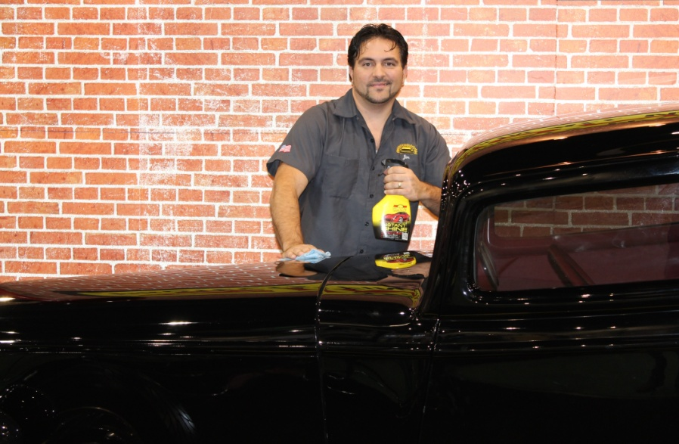

Simoniz® Distributor Program
Presented by:
Jim Dorsey II
National Accounts Manager
Jdorsey@simoniz.com
www.simoniz.com

Slide 2
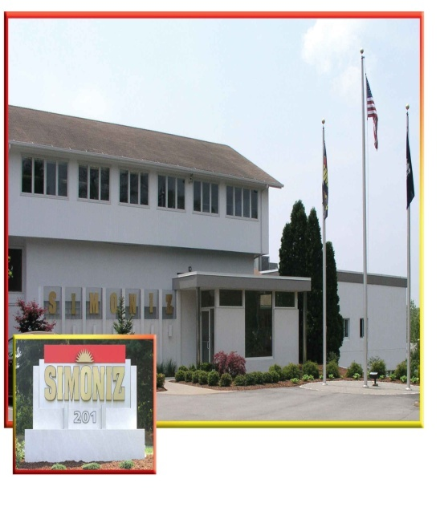
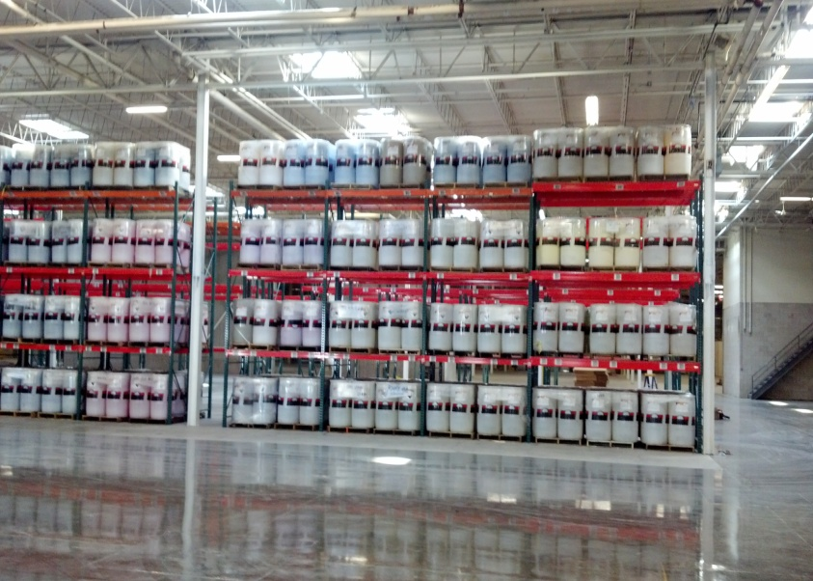
About Simoniz®
Since 1911, one of the oldest car appearance brand in the country. Operating our own manufacturing facility, producing chemicals with the strictest quality standards.
Owner of the Simoniz® Garage. A state of the art detailing and training facility offered to customers.
The single largest supplier in the US of appearance products to the professional car & truck wash and auto dealership industries.
A vision to place an emphasis on developing long- term alliances with progressive distribution partners nationwide.
To be a leader in innovation offering multiple solutions to our customers in diverse markets.

Slide 3

Why Simoniz®
Simoniz® has put together a structured, innovative, and proven program that will keep our distributors ahead of the curve.
Simoniz® has mastered a sales approach to address both “front and back of the house” business opportunities.
Distributors will have protected territories and have access to world-class marketing, sales and product training along with unparalleled support.
Distributors will be given generous discounts on premium quality products and merchandise.
Distributors will have access to Simoniz® diverse markets for one-stop selling.

Slide 4
The Simoniz® Difference
Simoniz® knows and understands in these trying economic times more and more businesses are looking for new and improved ways to increase customer satisfaction and grow their bottom line. The Simoniz® Program will be the solution to help customers succeed this challenge. Simoniz® will dedicate our time and expertise to execute the perfect strategy for your business. Above being a premium quality chemical manufacturer, Simoniz® provides thorough training, vibrant promotional materials and merchandise, and offers professional advice for a more organized, efficient work environment. The Simoniz® difference cannot compare to other suppliers. Simoniz® will be innovative, responsive, provide improved solutions, and lead the way in every area of the automobile appearance industry.

Slide 5




Simoniz® Diverse Markets
Detail Direct
Car Wash
Green Scene
Janitorial
Fleet Line Products
Aftermarket Paint & Fabric Protection
Retail Line Products

Slide 6
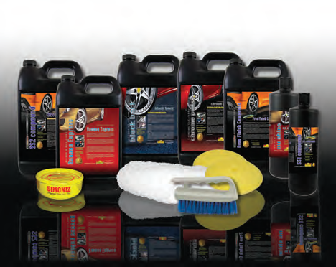

Simoniz® Offerings
Detail Direct
Fleet Line Products
Car Wash / Green Scene
Generous discounts on chemical purchases
Allowance towards merchandise: shirts, drum covers, banners, etc.
Discount on accessories
Training / certifications at no additional charge
Dealership menus and signs at no additional charge
Up to $1000.00 toward vehicle graphics
Protected Territories
Affordable freight rates/ Discount
No Contract

Slide 7

Simoniz® Offerings
Janitorial Line Products
Aftermarket Paint & Fabric Protection
Retail Line Products
These products and services will be addressed on a case by case basis.
Potential distributors may or may not have access to some of these type markets.

Slide 8
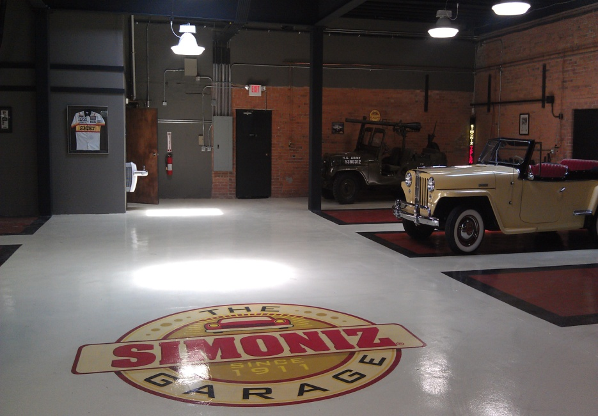
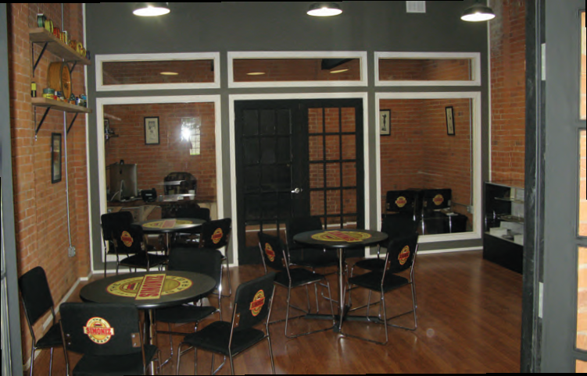
Simoniz® Program Training
Hands on / Simoniz® Garage
  On Site
  Simoniz® Trained Professionals
Multi Media – webcast
  English / Spanish
  Online Certification

Slide 9
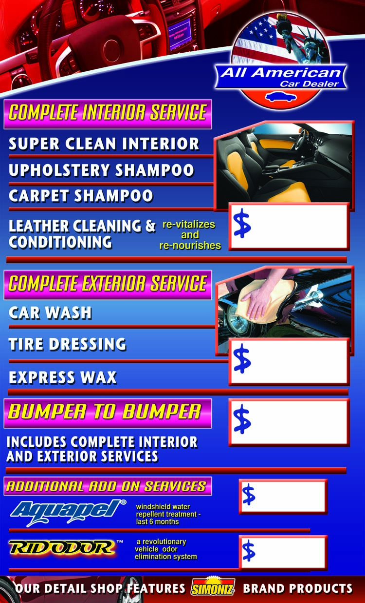


Slide 10
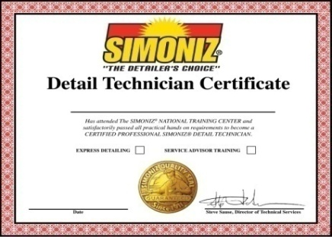

Simoniz® Benefits Summary
Name Brand-Premium quality products
Training / Certifications for distributors, service advisors, detail technicians
Point of Sale materials
Diverse markets for one-stop shopping
Merchandise Allowance / Vehicle Graphics
World-Class support / service
Competitive Pricing
Protected Territory

Slide 11
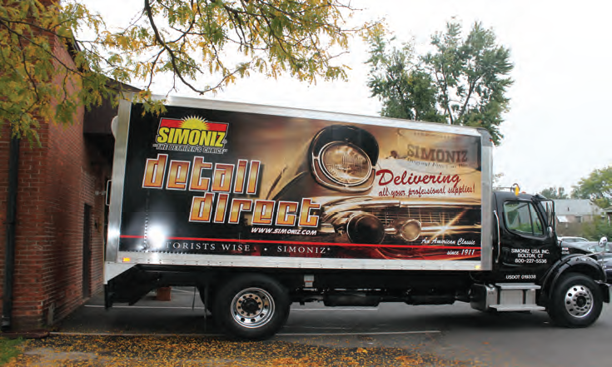
DRIVING SALES
DELIVERING PROFITABILITY

